Slide 1
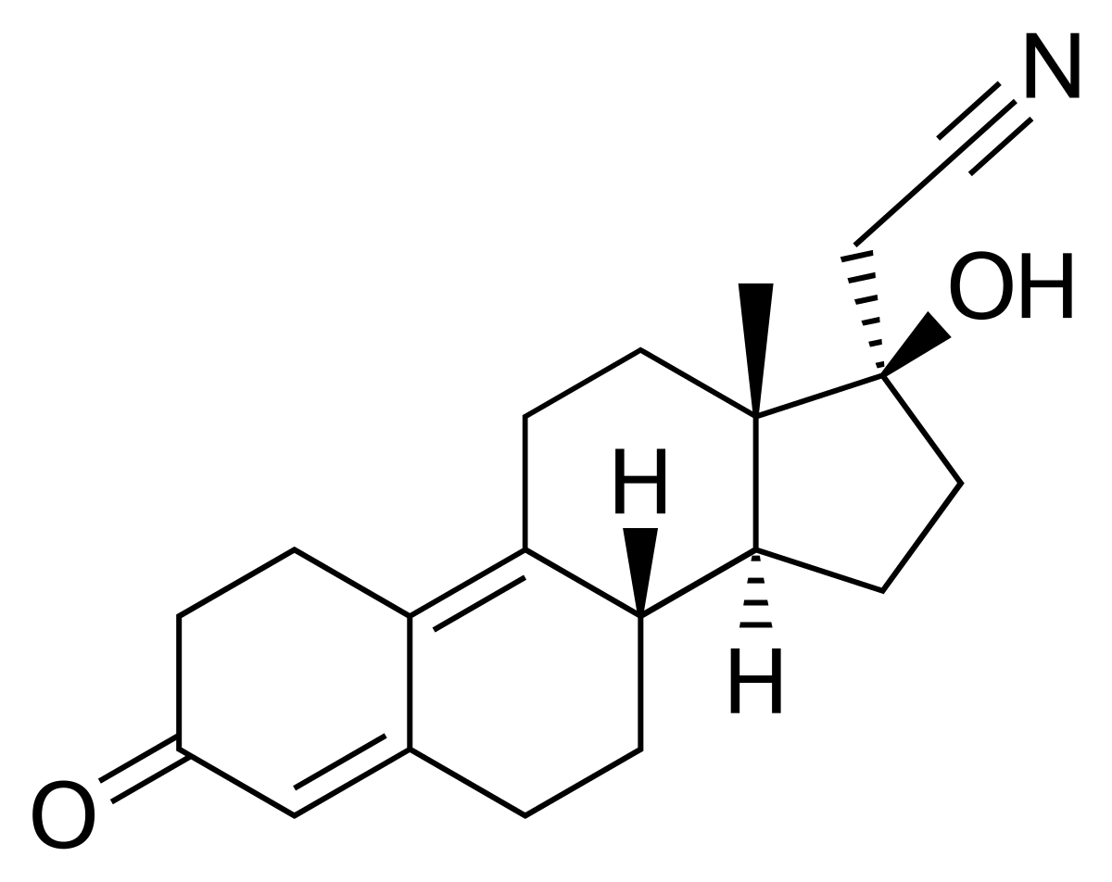
Motivation
C2H3N, mass=41
MSMS spectra of dienogest and TPs showed consistent neutral loss of 41 (methyl-cyanogroup on C17)
Potential for a high-throughput method for TP screening from MSMS files (autoMSMS with or without prefer list)
Idea similar to the “neutral loss scan” mode in QQQ
dienogest
-H2O, -18
-C2H3N, -41
dienogest
+ H2O
-H2O, -18
-C2H3N, -41
dienogest
- H2
-H2O, -18
-C2H3N, -41

Slide 2
Algorithm
① For MSMS of precursors with m/z 200-500 and RT 3-10 min, pick fragments with absolute height ≥ 10 counts;
② Pick TOP 5 fragments within [precursor-100, precursor];
③ Calculate neutral losses of these 5 fragments to all other fragments;
④ Check if the target neutral loss is present. Mass error: 0.01.
All the underscored parameters can be tuned according to different data and quality report to improve the selection performance
②
②
③
④
41
③
③
①

Slide 3
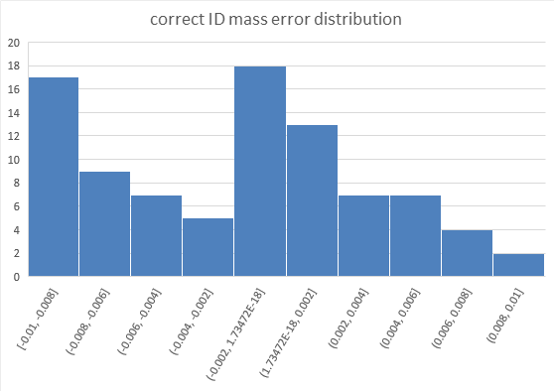
From autoMSMS with preferred list data file
one C2H3N lost TP;
one -41 fragment response low;
one unknown reason;
one new TP identified;
features present in control (pre-excluded during expert analysis);
Isotopes, adducts;
3
16
~40
(if Nina is an) expert knowledge
molecular motif algorithm

Slide 4
From autoMSMS without preferred list data file
TP with yield <1%
(estimated from peak area)
TP with yield >1%
(estimated from peak area)
Cpd present in TopN feature at least in one scan
16
3
~15
(if Nina is an) expert knowledge
molecular motif algorithm
It means that if we run samples through autoMSMS (without pref list) directly, most of the TPs features won’t be fragmentated (since it is not in the TOPN setting)

Slide 5
3 ways out – mostly on the instrument setting side
Do not aim for low-yield (low response) TPs..
Segregated the autoMSMS run to increase precursor coverage, e.g. precursor m/z 200-250, 250-300, 300-350…
Incorporate data pipeline of MS1 pre-selection into the workflow, so that pref list can be included during autoMSMS run.

